Slide 1

Inferences Based on Two Samples
Copyright © Cengage Learning. All rights reserved.

Slide 2
The Two-Sample t Test and Confidence Interval
Copyright © Cengage Learning. All rights reserved.

Slide 3
The Two-Sample t Test and Confidence Interval
Values of the population variances will usually not be known to an investigator. In the previous section, we illustrated for large sample sizes the use of a z test and CI in which the sample variances were used in place of the population variances.
In fact, for large samples, the CLT allows us to use these methods even when the two populations of interest are not normal.

Slide 4
The Two-Sample t Test and Confidence Interval
In practice, though, it will often happen that at least one sample size is small and the population variances have unknown values. Without the CLT at our disposal, we proceed by making specific assumptions about the underlying population distributions.
The use of inferential procedures that follow from these assumptions is then restricted to situations in which the assumptions are at least approximately satisfied.

Slide 5
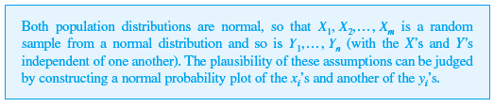
The Two-Sample t Test and Confidence Interval
We could, for example, assume that both population distributions are members of the Weibull family or that they are both Poisson distributions. It shouldn’t surprise you to learn that normality is typically the most reasonable assumption.
Assumptions

Slide 6
The Two-Sample t Test and Confidence Interval
The test statistic and confidence interval formula are based on the same standardized variable developed in Section 9.1, but the relevant distribution is now t rather than z.

Slide 7
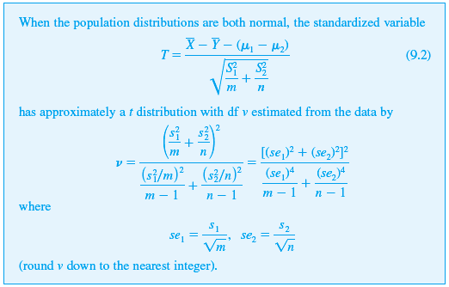
The Two-Sample t Test and Confidence Interval
Theorem
Manipulating T in a probability statement to isolate μ₁ – μ₂ gives a CI, whereas a test statistic results from replacing μ₁ – μ₂ by the null value Δ₀.

Slide 8
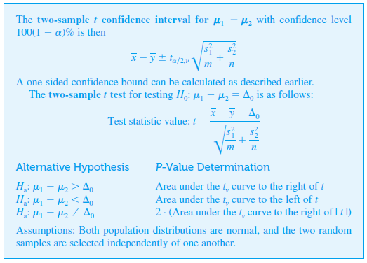
The Two-Sample t Test and Confidence Interval

Slide 9
Example 9.6
The void volume within a textile fabric affects comfort, flammability, and insulation properties. Permeability of a fabric refers to the accessibility of void space to the flow of a gas or liquid.
The article “The Relationship Between Porosity and Air Permeability of Woven Textile Fabrics” (J. of Testing and Eval., 1997: 108–114) gave summary information on air permeability (cm³/cm²/sec) for a number of different fabric types.

Slide 10
Example 9.6
cont’d
Consider the following data on two different types of plainweave fabric:

Slide 11
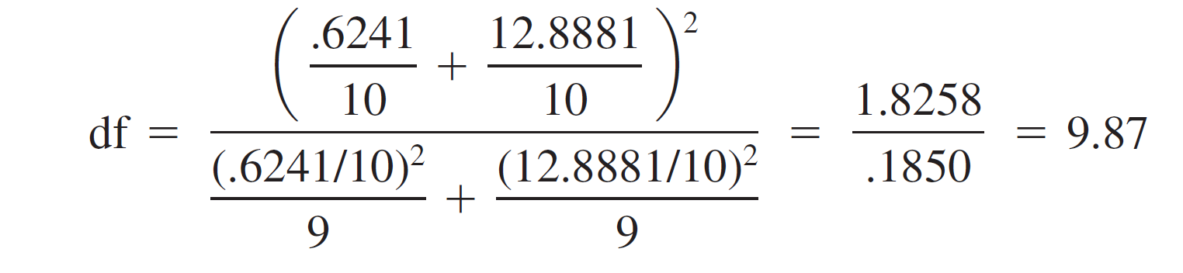
Example 9.6
cont’d
Assuming that the porosity distributions for both types of fabric are normal, let’s calculate a confidence interval for the difference between true average porosity for the cotton fabric and that for the acetate fabric, using a 95% confidence level.
Before the appropriate t critical value can be selected, df must be determined:

Slide 12
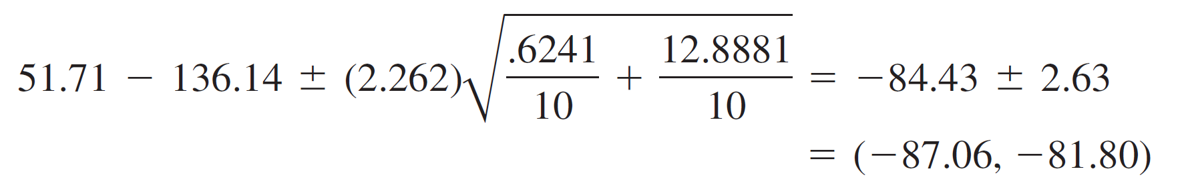
Example 9.6
cont’d
Thus we use v = 9; Appendix Table A.5 gives t_{.025,9} = 2.262. The resulting interval is
With a high degree of confidence, we can say that true average porosity for triacetate fabric specimens exceeds that for cotton specimens by between 81.80 and 87.06
cm3/cm2/sec.

Slide 13
Pooled t Procedure

Slide 14

Pooled t Procedures
Alternatives to the two-sample t procedures just described result from assuming not only that the two population distributions are normal but also that they have equal variances .
That is, the two population distribution curves are assumed normal with equal spreads, the only possible difference between them being where they are centered.

Slide 15

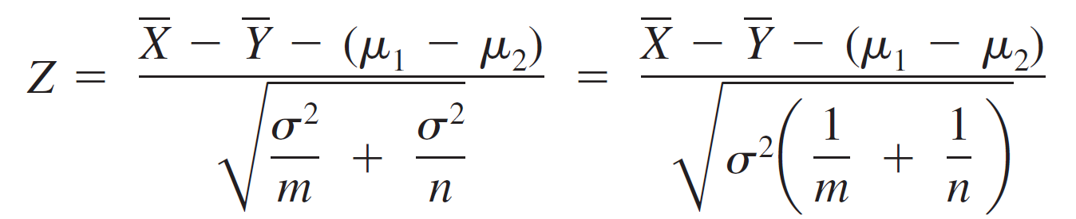
Pooled t Procedures
Let σ ² denote the common population variance. Then standardizing gives
which has a standard normal distribution. Before this variable can be used as a basis for making inferences about μ₁ – μ₂, the common variance must be estimated from sample data.

Slide 16

Pooled t Procedures
One estimator of σ ² is , the variance of the m observations in the first sample, and another is , the variance of the second sample. Intuitively, a better estimator than either individual sample variance results from combining the two sample variances.
A first thought might be to use
However, if m > n, then the first sample contains more information about σ ² than does the second sample, and an analogous comment applies if m < n.

Slide 17
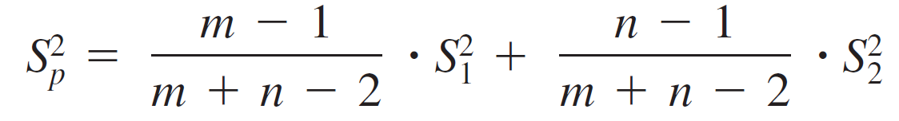
Pooled t Procedures
The following weighted average of the two sample variances, called the pooled (i.e., combined) estimator of σ ²,adjusts for any difference between the two sample
sizes:
The first sample contributes m – 1 degrees of freedom to the estimate of σ ², and the second sample contributes n – 1 df, for a total of m + n – 2 df.

Slide 18
Pooled t Procedures
Statistical theory says that if replaces σ ² in the expression for Z, the resulting standardized variable has a t distribution based on m + n – 2 df.
In the same way that earlier standardized variables were used as a basis for deriving confidence intervals and test procedures, this t variable immediately leads to the pooled t CI for estimating μ₁ – μ₂ and the pooled t test for testing hypotheses about a difference between means.

Slide 19
Pooled t Procedures
In the past, many statisticians recommended these pooled t procedures over the two-sample t procedures.
The pooled t test, for example, can be derived from the likelihood ratio principle, whereas the two-sample t test is not a likelihood ratio test.
Furthermore, the significance level for the pooled t test is exact, whereas it is only approximate for the two-sample t test.

Slide 20
Pooled t Procedures
However, recent research has shown that although the pooled t test does outperform the two-sample t test by a bit (smaller β 's for the same α) when the former test can easily lead to erroneous conclusions if applied when the variances are different.
Analogous comments apply to the behavior of the two confidence intervals. That is, the pooled t procedures are not robust to violations of the equal variance assumption.

Slide 21
Pooled t Procedures
It has been suggested that one could carry out a preliminary test of and use a pooled t procedure if this null hypothesis is not rejected. Unfortunately, the usual “F test” of equal variances is quite sensitive to the assumption of normal population distributions—much more so than t procedures.
We therefore recommend the conservative approach of using two-sample t procedures unless there is really compelling evidence for doing otherwise, particularly when the two sample sizes are different.

Slide 22
Type II Error Probabilities

Slide 23
Type II Error Probabilities
Determining type II error probabilities (or equivalently, power = 1 – β ) for the two-sample t test is complicated. There does not appear to be any simple way to use the β curves of Appendix Table A.17.
The most recent version of Minitab (Version 16) will calculate power for the pooled t test but not for the two- sample t test.
However, the UCLA Statistics Department homepage (http://www.stat.ucla.edu) permits access to a power calculator that will do this.

Slide 24
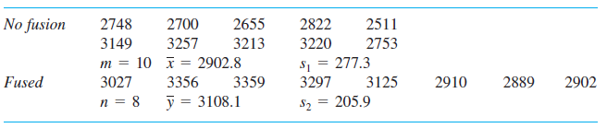
Type II Error Probabilities
For example, we specified m = 10, n = 8, σ₁ = 300, σ₂ = 225 (as shown in the below table, whose sample standard deviations are somewhat smaller than these values of σ₁ and σ₂) and asked for the power of a two-tailed level .05 test of H₀: μ₁ – μ₂ = 0 when μ₁ – μ₂ = 100, 250 and 500.

Slide 25
Type II Error Probabilities
The resulting values of the power were .1089, .4609,and .9635 (corresponding to β = .89, .54, and .04), respectively. In general, β will decrease as the sample sizes increase, as α increases, and as μ₁ – μ₂ moves farther from 0.
The software will also calculate sample size necessary to obtain specified value of power for a particular value of μ₁ – μ₂

